Slide 1
COVID-19
Yuval Kadosh & Hadar Buchman
GitHub

Slide 2
Our research:
Can we predict high morbidity of covid-19 by country attributes?

Slide 3
About COVID-19
The COVID-19 pandemic (also known as the coronavirus pandemic) is an ongoing global pandemic of coronavirus disease 2019 (COVID-19), which is caused by severe acute respiratory syndrome coronavirus 2 (SARS-CoV-2).
The virus was first identified in December 2019 in Wuhan, China.
PANDEMIC
COVID-19

Slide 4
About our research
Can we predict high morbidity of covid-19 by country attributes?
In our research we tried to find a connection between the main attributes of a country to the covid-19 morbidity.
We crawled to a few sites, to collect different interesting attributes for all the countries and we used the positive tests rate to measure the morbidity, calculated by dividing the total covid-19 cases amount in the country by the total amount of covid-19 tests made.
We checked the relation of each attribute with the positive tests rate and created a linear regression model to predict the positive tests rate in a country by the data we crawled.

Slide 5
Country attributes
POPULATION
LAND AREA
% OF WORLD LANDMASS
a number of all the organisms of the same group or species who live in a particular geographical area and are capable of interbreeding
a country's total area
The country percent of world's land area
GDP
UNEMPLOYMENT RENT
COUNTRY AGE
The unemployment rent in the country
a monetary measure of the market value of all the final goods and services produced in a specific time period
MEDIAN AGE
The median age in the country

Slide 6
Main Steps
Process steps
Data acquisition
Data Cleaning
EDA
ML

Slide 7
Data sources
01
WORLDOMETER
02
IMF
03
TUTORIALSPOINT
04
WIKIPEDIA

Slide 8

Data Acquisition
Crawling
We used requests to get the content of the html
And pandas.read_html() automatic function that
reads html tables into dataframes.
Because our data is taken from multiple websites,
we created a function and a dataframe for each
website and merged them all together to a final dataframe.

Slide 9
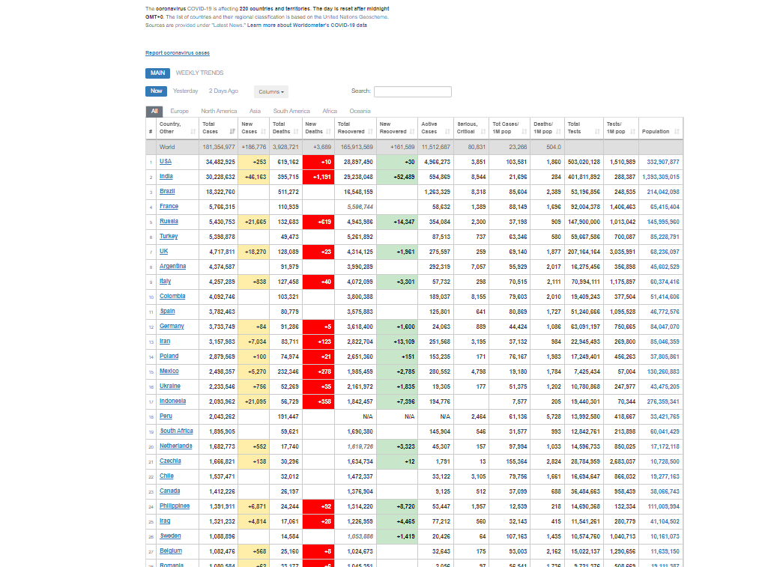
worldometers - Crawling
crawl_covid_data()
Total Cases of Covid-19 in the country
Total Covid-19 tests made in the country
The population of the country
crawl_area_data()
The land area in squared Km and
% of the world mass
03
04

Slide 10
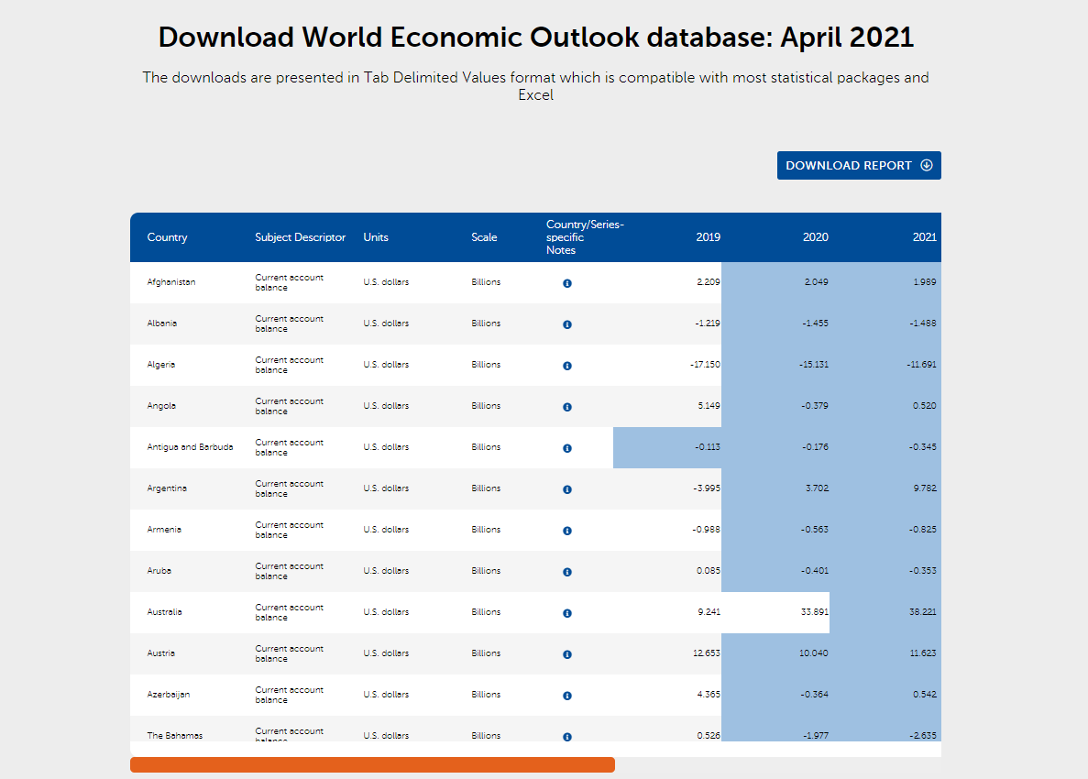
IMF - crawling
crawl_GDP_data()
Gross domestic product of each country
crawl_unemployment_data()
Unemployment rate of each country

Slide 11
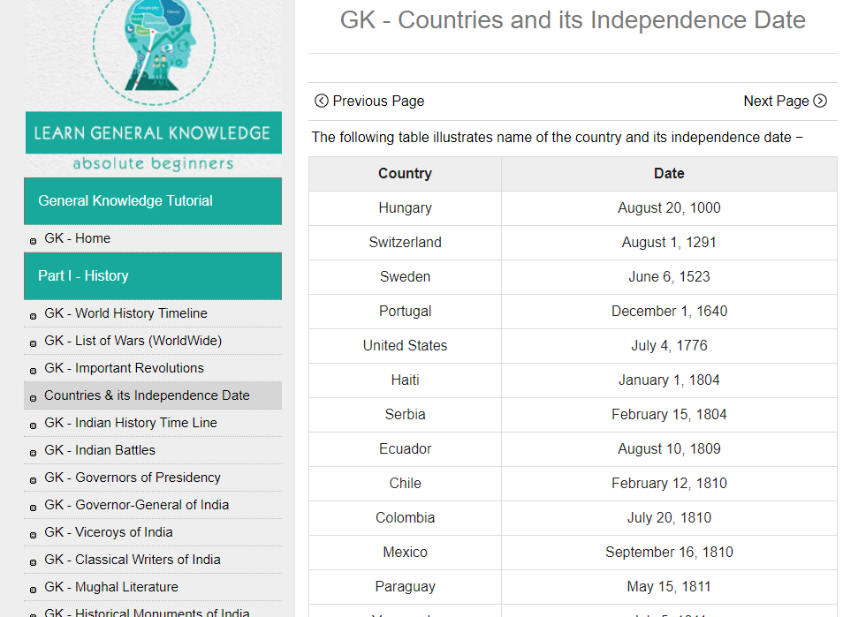
Tutorialspoint - crawling
crawl_country_age_data()
The independence date of each country, which
will be converted to age

Slide 12
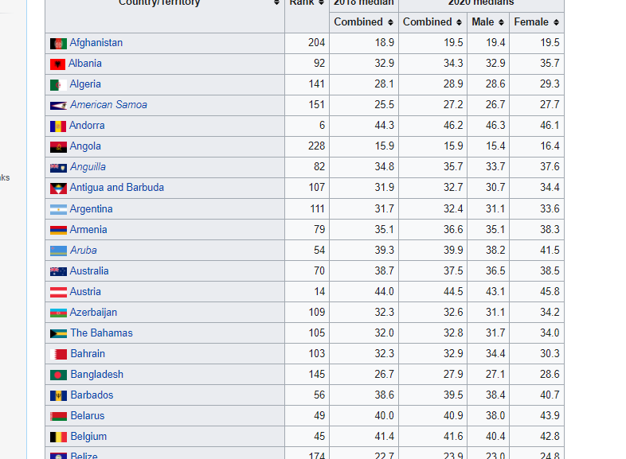
WIKIPEDIA - crawling
crawl_median_age_data()
The median age of each country in the year 2018 & 2020
02
03
04

Slide 13


Initial Data Treating
Changed The Columns Names
To make all the dataframes match
Took The needed Columns
Removed the unneeded data
Adjusted The Data
Converted the data to numeric values, for example from dates to age in numbers

Slide 14
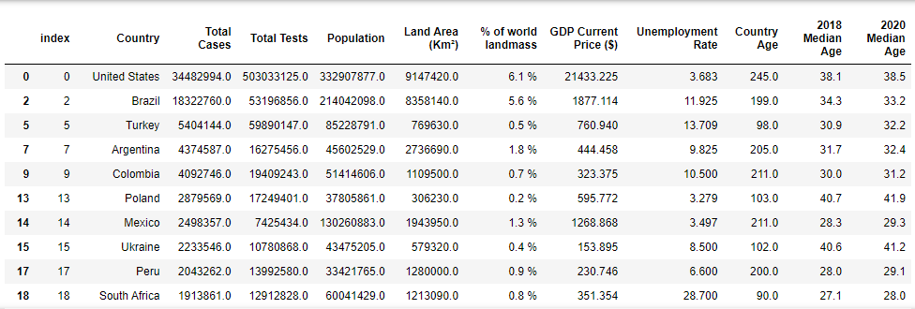
Data Merging
WorldOmeters
One big DataFrame
IMF
ToturialsPoint
Wikipedia

Slide 15
Data Cleaning– Outliers
Scaling -
Visualizing
We used boxplot to see the outliers and then,
we used the interquartile range method to find the outliers and removed them
Calculate
IQR
Removing
Outliers

Slide 16
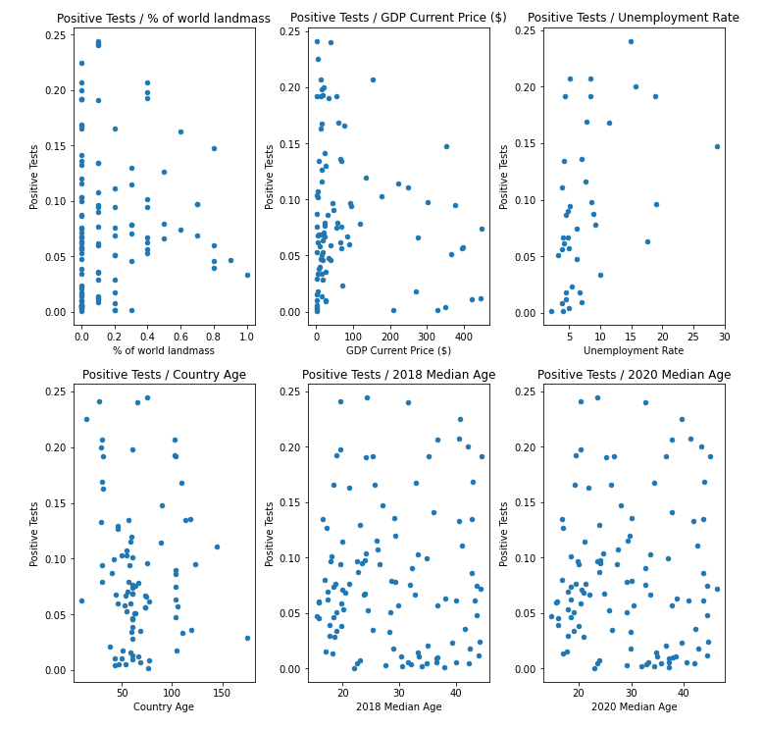
Country Attributes Relation To Positive Tests Rate
EDA -
Data Visualization

Slide 17
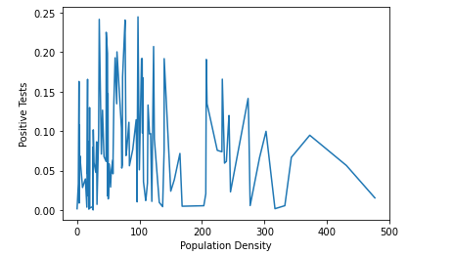
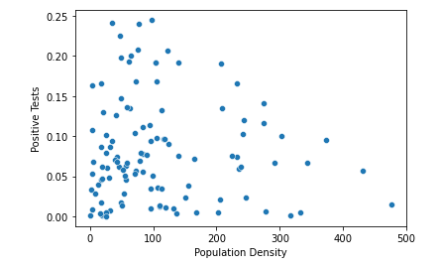
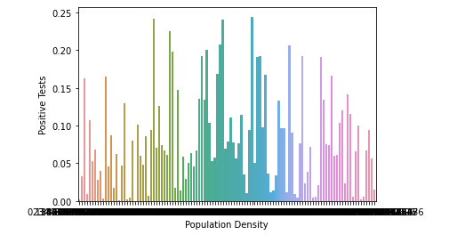
Population Density Relation To Positive Tests Rate
EDA -
Data Visualization

Slide 18
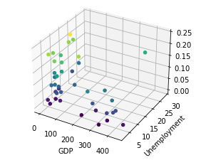
GDP, Unemployment Rate And Positive Tests Rate Relation
In 3 Dim Plot
EDA -
Data Visualization

Slide 19
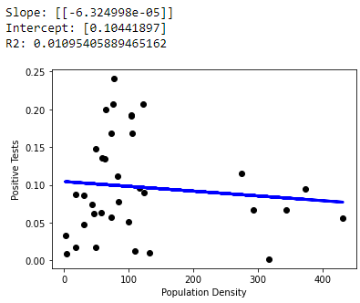
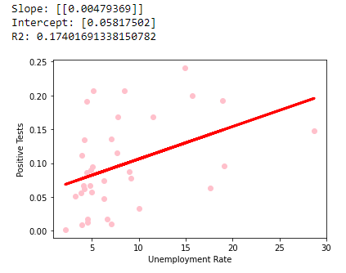
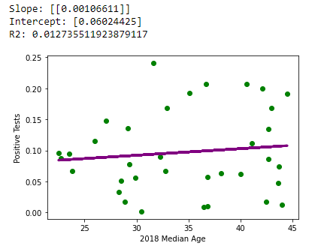
Linear Regression - Population
Population Density / Positive Tests
We used the LinearRegression function in sklearn module which finds the linear regression between the parameters given to it. It fits a linear model to minimize to residual sum of squares between the given coulmns in the dataset, so that the next targets will be predicted by the linear approximation
Further Examples:

Slide 20
Conclusions
Population Density
We saw that population density is not a major factor in covid-19 morbidity as we expected it to be.
GDP
We saw the countries with higher GDP have lower positive tests rate
Unemployment
We saw that countries with higher unemployment rate tend to have higher
positive tests rate
Overall attributes
We saw that we couldn’t find a strong connection between the country attributes
and the positive tests rate

Slide 21
THANK YOU
For watching

